Slide 1
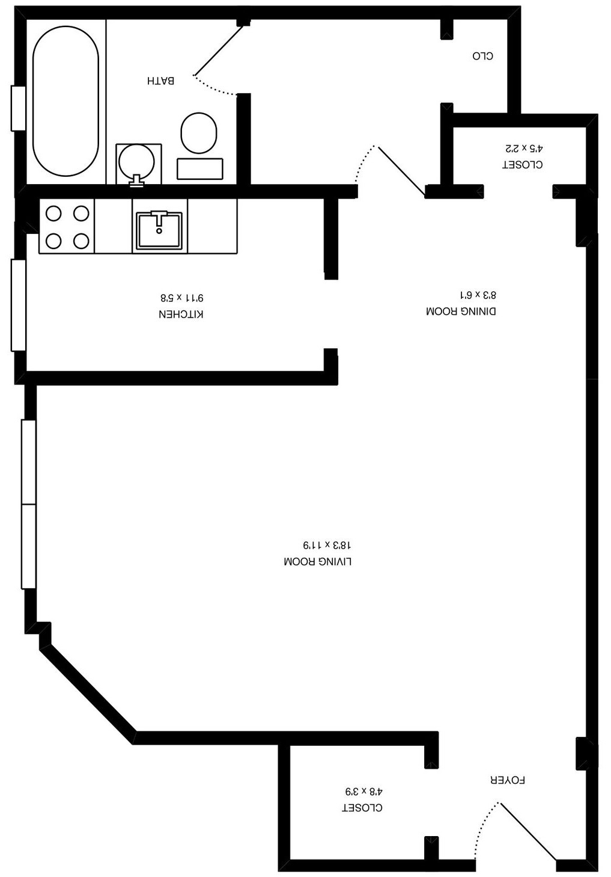

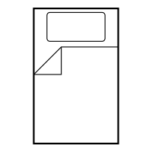
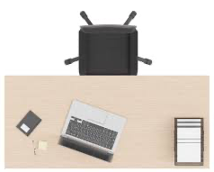
Small Rack
DRESSER
Plastic STORAGE
WIRE SHELF
TRASH
NIGHT
STAND
BOOKSHELF
Plastic STORAGE
SHOES

